Slide 1



Mentored By:
Dr. Jatinder Pal Singh

Slide 2






PDF Helper
AbAbdul Rehman (GCS 2040305)
Chandramauil Gupta (GCS 2040162)
Shashwat (GCS 2040395)

Slide 3
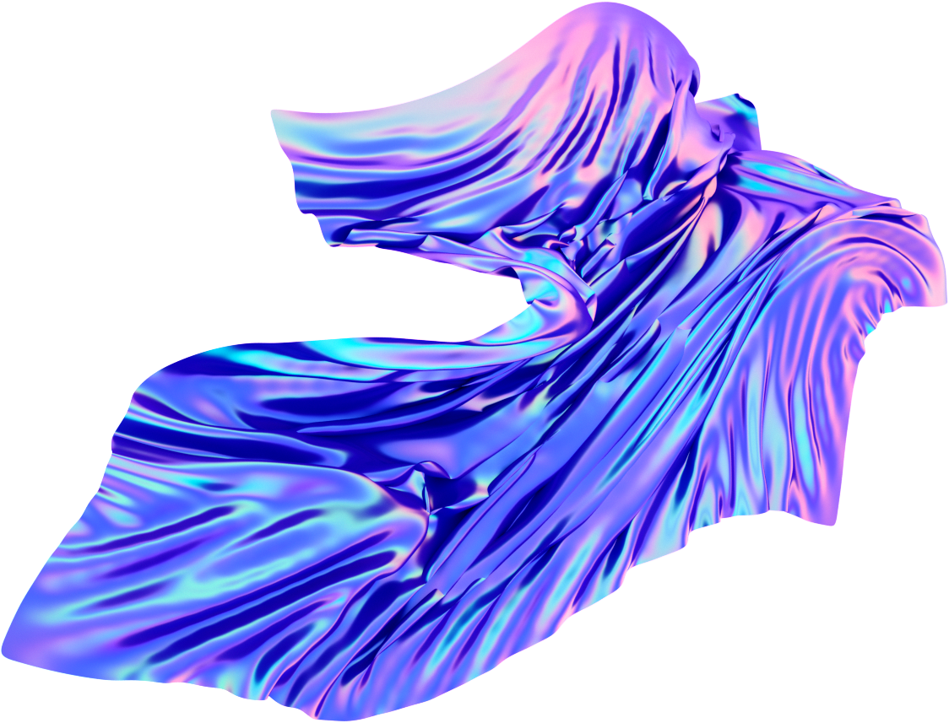

About PDF Helper
The core objective of PDF Helper is to facilitate users in interacting with PDF documents in a more intuitive and dynamic manner.With the application of the BERT model (Bidirectional Encoder Representations from Transformers), this project demonstrates the potential of deep learning models in extracting meaningful insights from intricate textual data.

Slide 4


PROPOSED WORK
The proposed work for the PDF Helper project involves a systematic exploration of the capabilities offered by the BERT model in conjunction with the Flask web framework.

Slide 5


OBJECTIVES
Enhance Information Retrieval from PDFs
Streamline Document Understanding
Promote Learning and Research
User-Friendly Document Exploration
Efficient Document Review

Slide 6
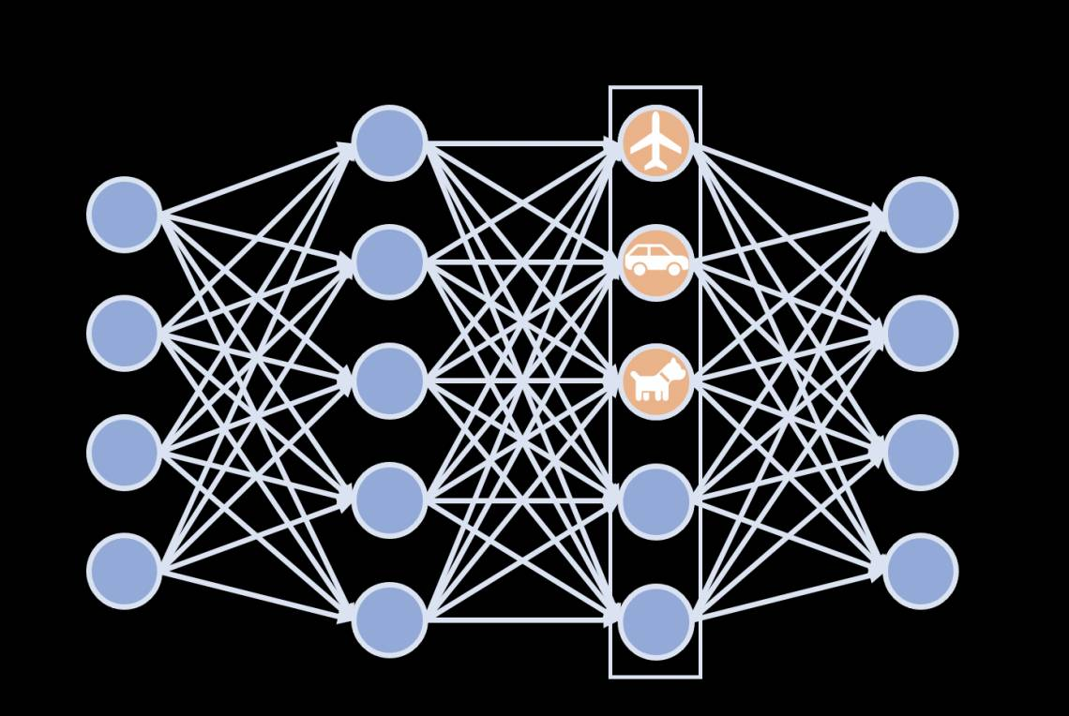
Deep Learning

Slide 7
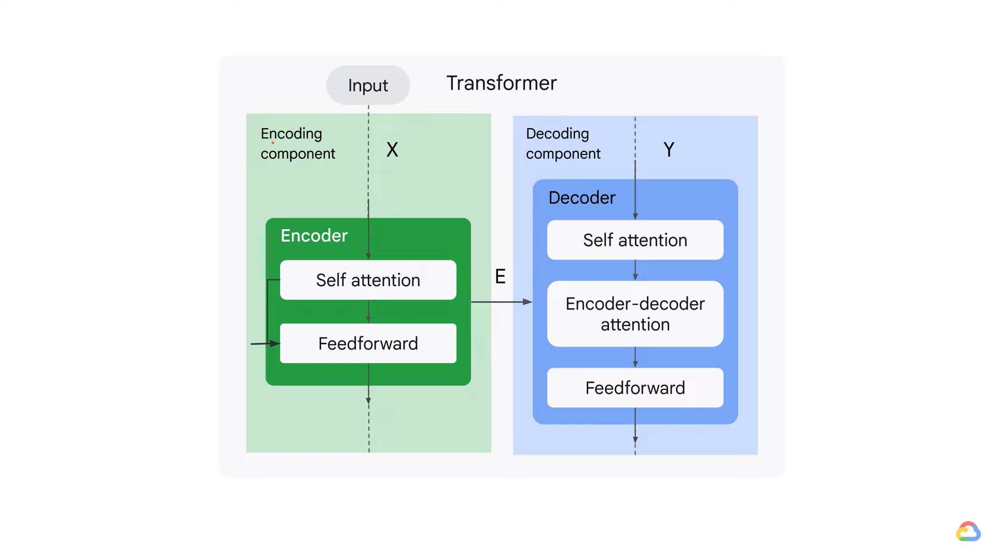


Slide 8
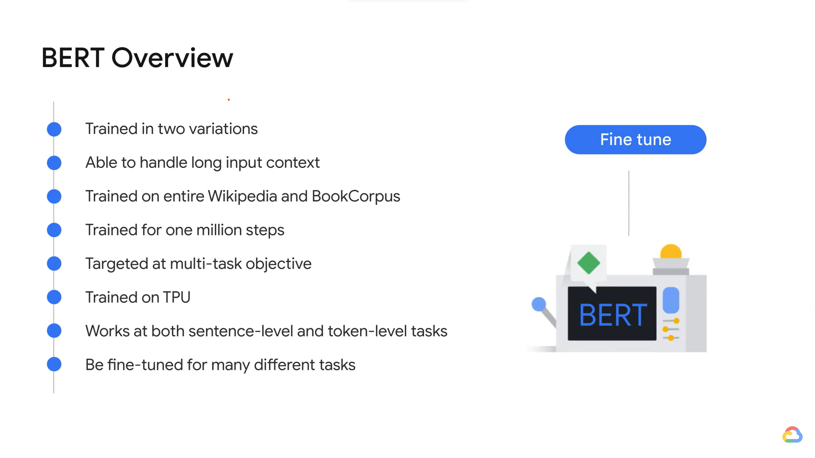

Slide 9
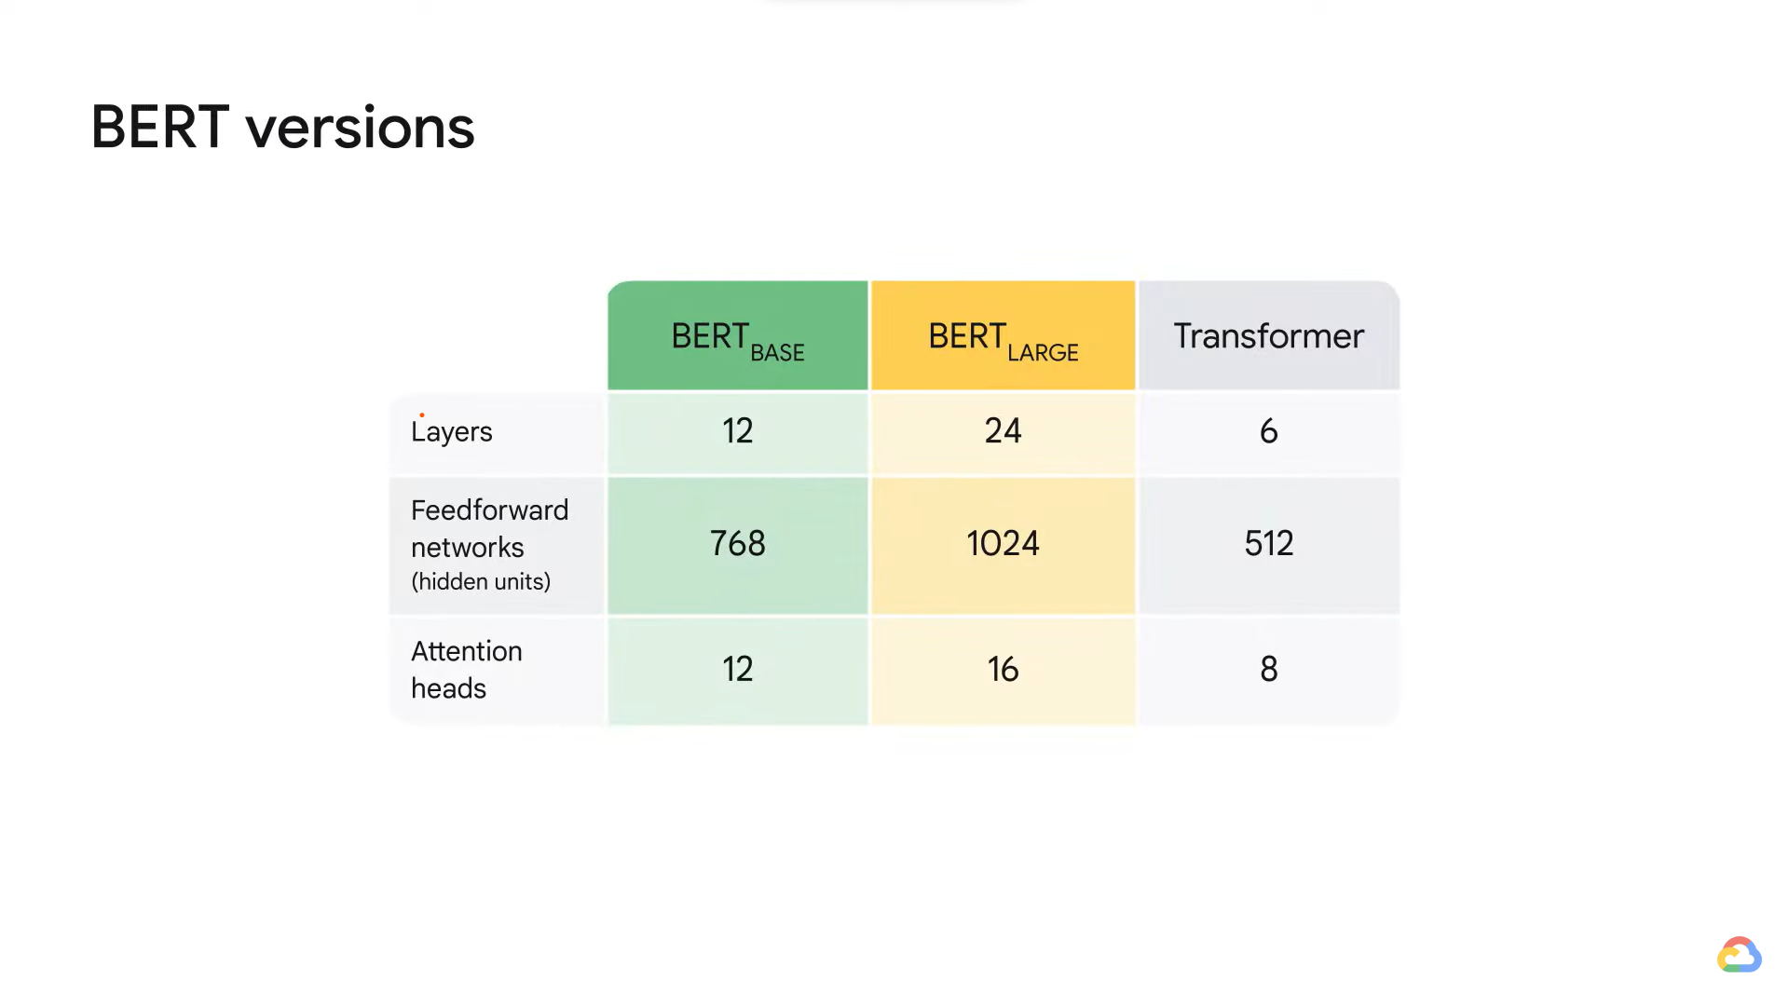

Slide 10
What we are planing to do
Data Preprocessing
BERT Model Integration
Flask Web Framework Deployment
User Input Processing
BERT Inference and Response Generation
User Interface Design
Testing and Evaluation

Slide 11



Functionality
keywords
Extraction
Condensing
Q/A
Linguistic Help

Slide 12
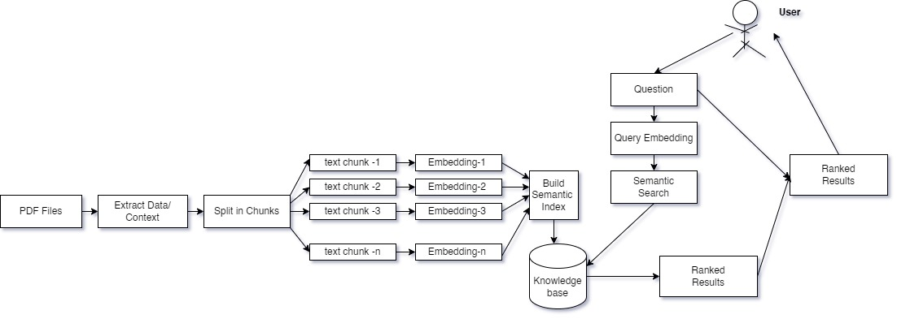
Flow Chart

Slide 13

Variants
M-Bert
P-Bert
C-Bert
110 million parameters
220 million parameters
340 million parameters

Slide 14
Technologies
1. Flask
2. Python
3. PDF Processing Tools (Eg-py2PDF)
4. Large Language model (LLM)
5. HTML/CSS/JAVASCRIPT
6. NLP Libraries

Slide 15
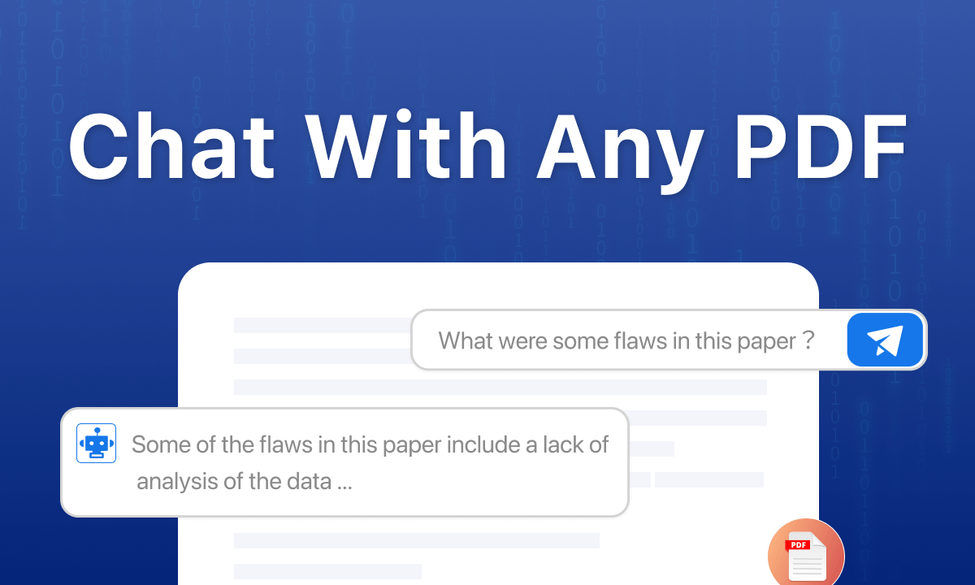
Interface

Slide 16
Limitations
Monolingual ( English)
Can’t parse images
Context Length

Slide 17
HARDWARE REQUIREMENTS
Minimum 8GB RAM (16GB recommended).
Adequate storage with SSD recommended.
Optional but recommended GPU for accelerated computations.
Internet connectivity for updates and potential cloud integration.

Slide 18
SOFTWARE REQUIREMENTS
Linux-based OS, or Windows/macOS (preferred).
Python 3.x with TensorFlow or PyTorch for BERT model.
Virtual environment and package manager for dependency management.
Web browser compatibility (Chrome, Firefox, Safari).

Slide 19
Future Prospect
Text from image
Extending to other formats
Support for regional languages
Output as Infographics

Slide 20

Team
Abdul Rehman
Chandramauli Gupta
Shashwat
Responsible for machine learning tasks
Responsible for Deploymnet of ML taks
Responsible for Web inteface

Slide 21
Thank You

